Slide 1


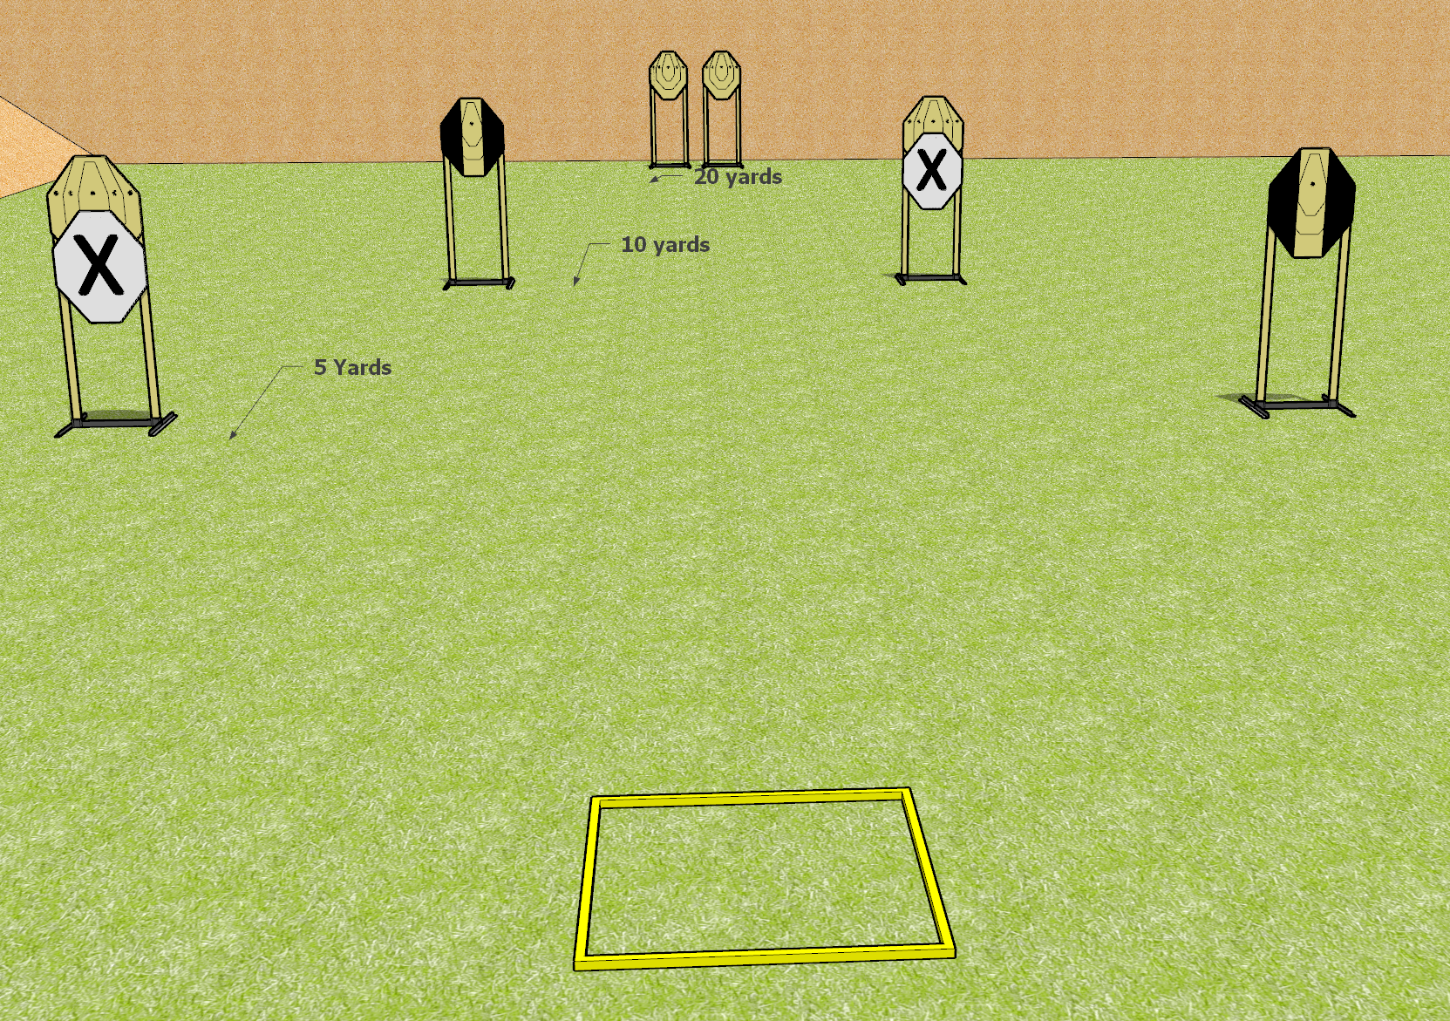
 | Dothan Gun Club – USPSA Match Wait this isn’t a Classifier? Course Designer : Drew Coleman
START POSITION : Standing in shooting box, hands relaxed at sides OR facing uprange, wrists above respective shoulders. PCC shouldered pointing at cone, OR buttstock on belt pointed generally at cone.
GUN READY CONDITION : Pistol loaded and holstered. PCC loaded. |  | SCORING: Comstock, X rounds TARGETS: X paper, X Steel SCORED HITS: Best 2 on paper, steel until down START-STOP: Audible, last shot RULES: failing to perform a mandatory reload will be a procedural per shot fired. Failing to fire strong hand only will be a procedural per shot fired.
STAGE PROCEDURE: Array 1: left 3 paper targets. Array 2: right 3 paper targets. String 1: engage either array with 2 rounds each, perform a mandatory reload and engage the remaining array strong hand only. String 2: using the opposite start position from string 1, engage either array with 2 rounds each, perform a mandatory reload and engage the remaining array freestyle with 2 rounds each.

